Slide 1
Self-calibration
Class 21
Multiple View Geometry
Comp 290-089
Marc Pollefeys

Slide 2
Content
Background: Projective geometry (2D, 3D), Parameter estimation, Algorithm evaluation.
Single View: Camera model, Calibration, Single View Geometry.
Two Views: Epipolar Geometry, 3D reconstruction, Computing F, Computing structure, Plane and homographies.
Three Views: Trifocal Tensor, Computing T.
More Views: N-Linearities, Self-Calibration, Multiple view reconstruction, Bundle adjustment, Dynamic SfM, Cheirality, Duality

Slide 3

Multi-view geometry

Slide 4
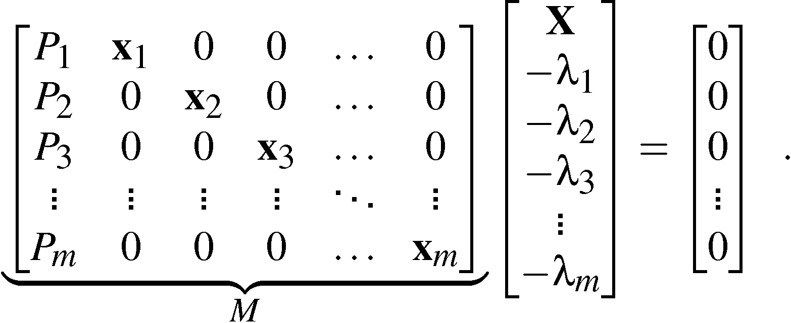
Matrix formulation
Consider one object point X and its m images: λ_{i}x_{i}=P_{i}X_{i}, i=1, …. ,m:
(3m x (m+4))
i.e. rank(M) < m+4 .

Slide 5
Laplace expansions
The rank condition on M implies that all (m+4)x(m+4) minors of M are equal to 0.
These can be written as sums of products of camera matrix parameters and image coordinates.
det

Slide 6
Matrix formulation
det
for non-trivially zero minors, one row has to be taken from each image (m).
4 additional rows left to choose

Slide 7
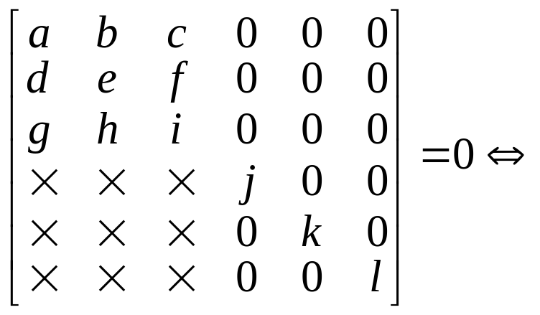
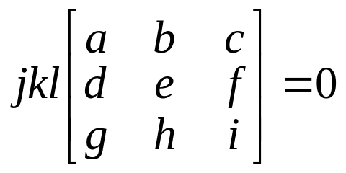
only interesting if 2 or 3 rows from view
det

Slide 8
The three different types
Take the 2 remaining rows from one image block and the other two from another image block, gives the 2-view constraints.
Take the 2 remaining rows from one image block 1 from another and 1 from a third, gives the 3-view constraints.
Take 1 row from each of four different image blocks, gives the 4-view constraints.

Slide 9
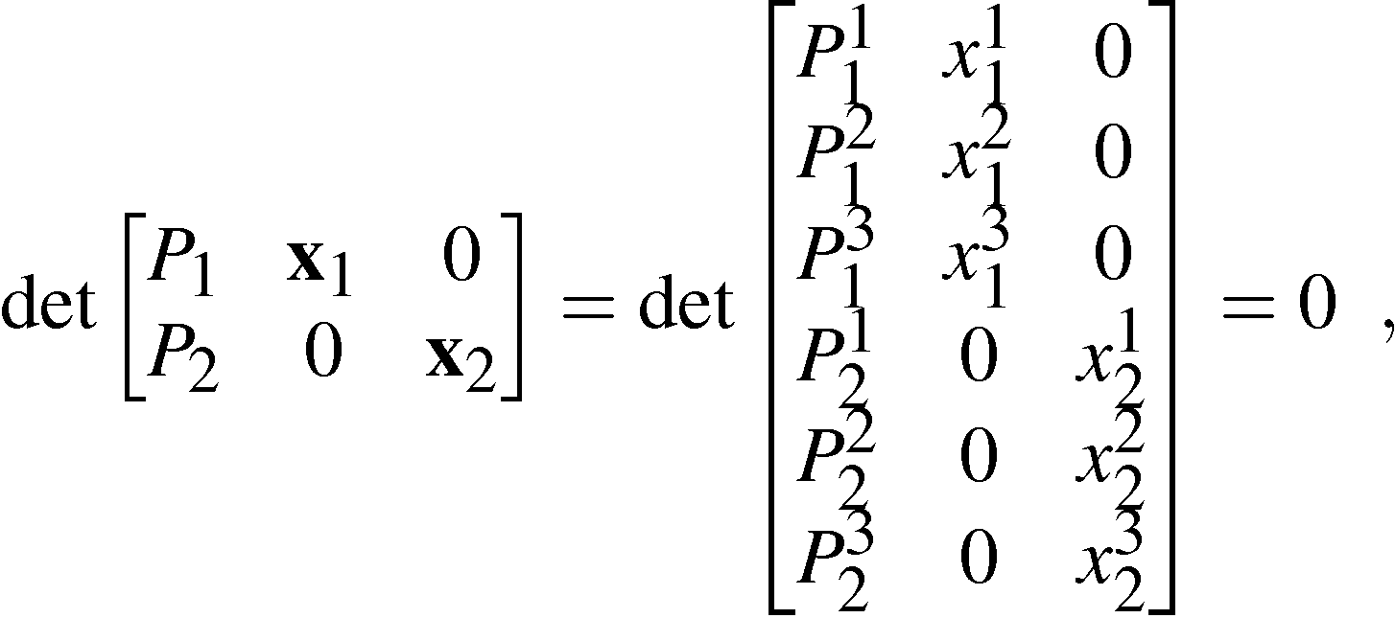
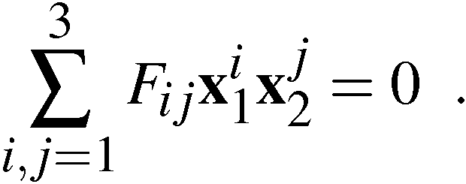
The two-view constraint
Consider minors obtained from three rows from one image block and three rows from another:
which gives the bilinear constraint:

Slide 10
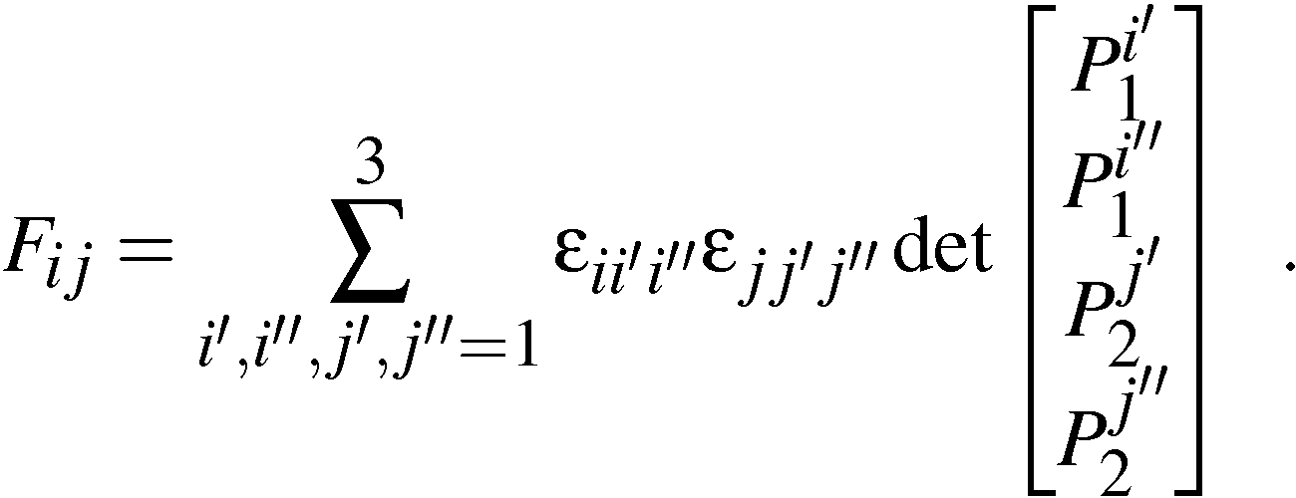
The bifocal tensor
The bifocal tensor F_{ij} is defined by
Observe that the indices for F tell us which row to exclude from the camera matrix.
The bifocal tensor is covariant in both indices.

Slide 11
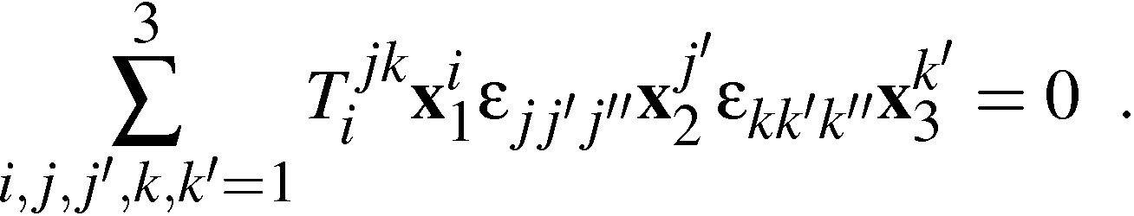
The three-view constraint
Consider minors obtained from three rows from one image block, two rows from another and two rows from a third:
which gives the trilinear constraint:

Slide 12
The trilinear constraint
Note that there are in total 9 constraints indexed by j’’ and k’’ in
Observe that the order of the images are important, since the first image is treated differently.
If the images are permuted another set of coefficients are obtained.

Slide 13
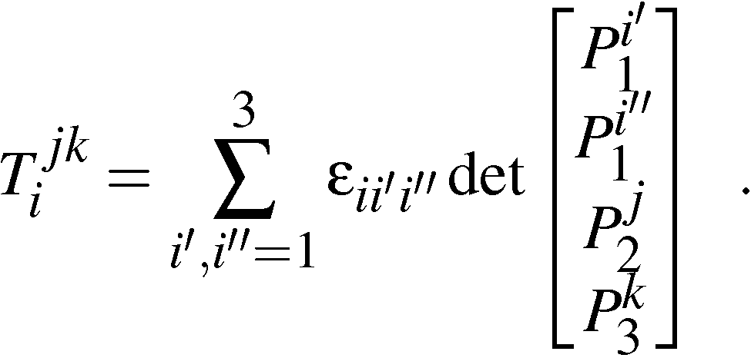
The trifocal tensor
The trifocal tensor T_{i}^{jk} is defined by
Observe that the lower indices for T tell us which row to exclude and the upper indices tell us which row to include from the camera matrix.
The trifocal tensor is covariant in one index and contravariant in the other two indices.

Slide 14
The four-view constraint
Consider minors obtained from two rows from each of four different image blocks gives the quadrilinear constraints:
Note that there are in total 81 constraints indexed by i’’, j’’, k’’ and l’’ (of which 16 are lin. independent).

Slide 15
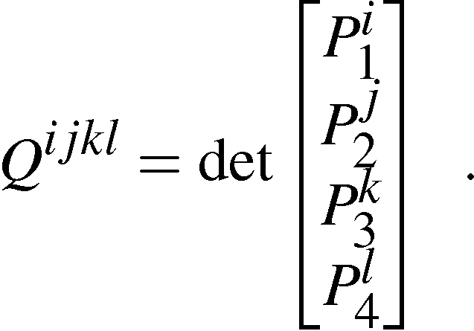
The quadrifocal tensor
The quadrifocal tensor Q^{ijkl} is defined by
Again the upper indices tell us which row to include from the camera matrix.
The quadrifocal tensor is contravariant in all indices.

Slide 16
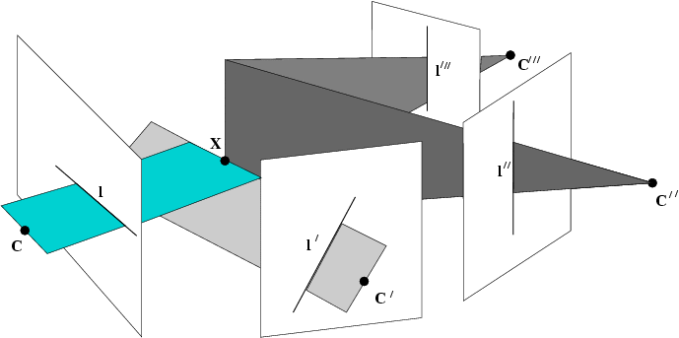
Geometric interpretation
x”’
x”
x
x’

Slide 17
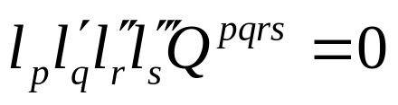
The quadrifocal tensor and lines
Lines do not have to come from same 3D line, but only have to pass through same point

Slide 18
Self-calibration

Slide 19
Outline
Introduction
Self-calibration
Dual Absolute Quadric
Critical Motion Sequences

Slide 20
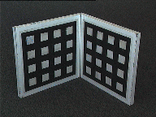
Motivation
Avoid explicit calibration procedure
  Complex procedure
  Need for calibration object
  Need to maintain calibration

Slide 21
Motivation
Allow flexible acquisition
  No prior calibration necessary
  Possibility to vary intrinsics
  Use archive footage

Slide 22
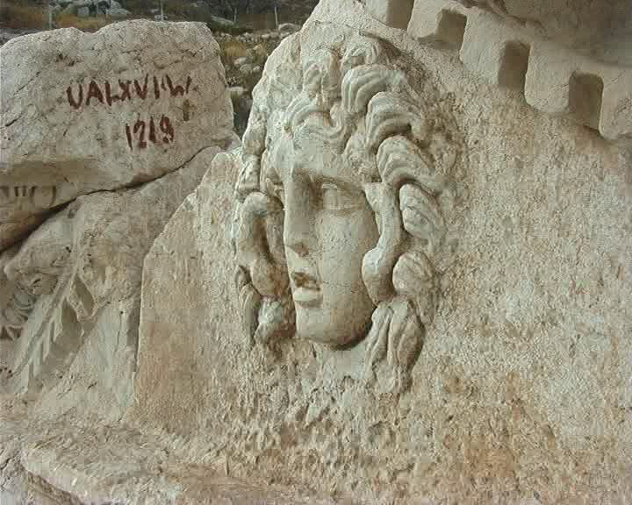
Example

Slide 23
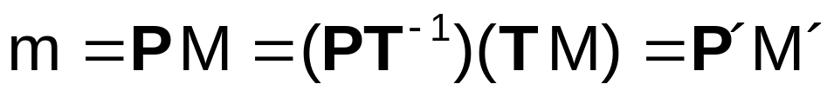
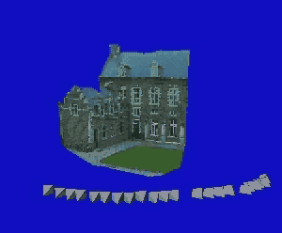
Projective ambiguity
Reconstruction from uncalibrated images
⇒ projective ambiguity on reconstruction

Slide 24
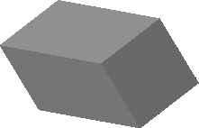
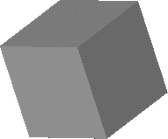
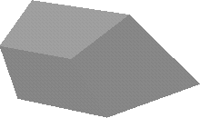
Stratification of geometry
Projective
Affine
Metric
15 DOF
7 DOF
absolute conic
angles, rel.dist.
12 DOF
plane at infinity
parallelism
More general
More structure

Slide 25
Constraints ?
Scene constraints
  Parallellism, vanishing points, horizon, ...
  Distances, positions, angles, ...
Unknown scene → no constraints
Camera extrinsics constraints
  Pose, orientation, ...
Unknown camera motion → no constraints
Camera intrinsics constraints
  Focal length, principal point, aspect ratio & skew
Perspective camera model too general
→ some constraints

Slide 26
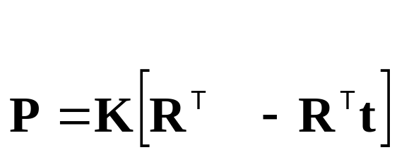
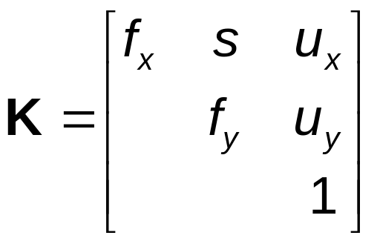
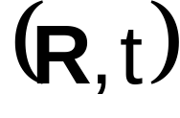
Euclidean projection matrix
Factorization of Euclidean projection matrix
Intrinsics:
(camera geometry)
Extrinsics:
(camera motion)
Note: every projection matrix can be factorized,
but only meaningful for euclidean projection matrices

Slide 27
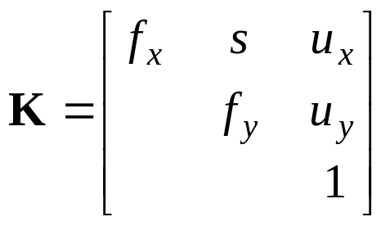
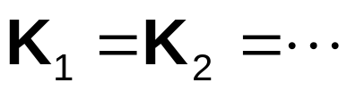

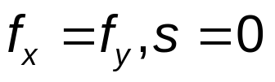
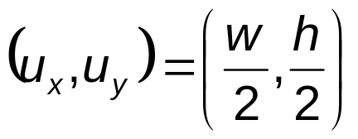
Constraints on intrinsic parameters
Constant
  e.g. fixed camera:
Known
  e.g. rectangular pixels:
  square pixels:
  principal point known:

Slide 28
Self-calibration
Upgrade from projective structure to metric structure using constraints on intrinsic camera parameters
  Constant intrinsics
  Some known intrinsics, others varying
  Constraints on intrincs and restricted motion
    (e.g. pure translation, pure rotation, planar motion)
(Faugeras et al. ECCV´92, Hartley´93,
Triggs´97, Pollefeys et al. PAMI´98, ...)
(Heyden&Astrom CVPR´97, Pollefeys et al. ICCV´98,...)
(Moons et al.´94, Hartley ´94, Armstrong ECCV´96, ...)

Slide 29
A counting argument
To go from projective (15DOF) to metric (7DOF) at least 8 constraints are needed
Minimal sequence length should satisfy
Independent of algorithm
Assumes general motion (i.e. not critical)

Slide 30
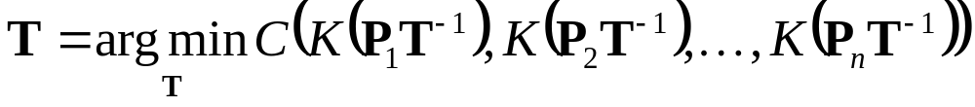
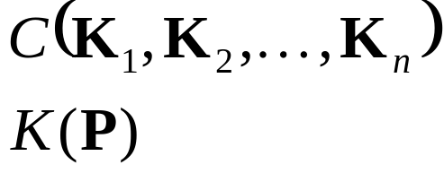
Self-calibration: conceptual algorithm
Given projective structure and motion {P_{j},M_{i}}, then the metric structure and motion can be obtained as {P_{j}T⁻¹,TM_{i}}, with
criterium expressing constraints
function extracting intrinsics
from projection matrix

Slide 31
Outline
Introduction
Self-calibration
Dual Absolute Quadric
Critical Motion Sequences

Slide 32











Conics & Quadrics
conics
quadrics
transformations
projection

Slide 33
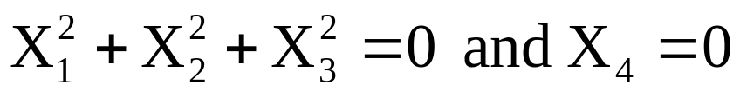
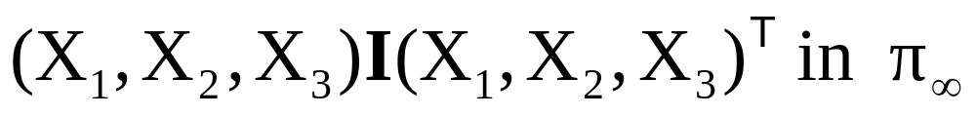
The Absolute Conic
ω∞ is a specific imaginary conic on π∞,
  for metric frame
  or
Remember, the absolute conic is fixed under H
if, and only if, H is a similarity transformation
Image related to intrinsics

Slide 34
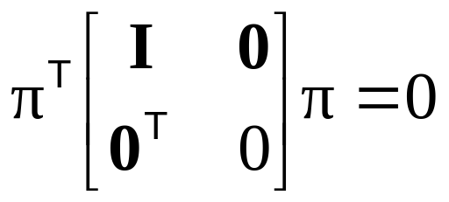
The Absolute Dual Quadric
(Triggs CVPR´97)
Degenerate dual quadric Ω*∞
Encodes both absolute conic ω∞ and π∞
π∞
ω∞
Ω*∞
for metric frame:

Slide 35
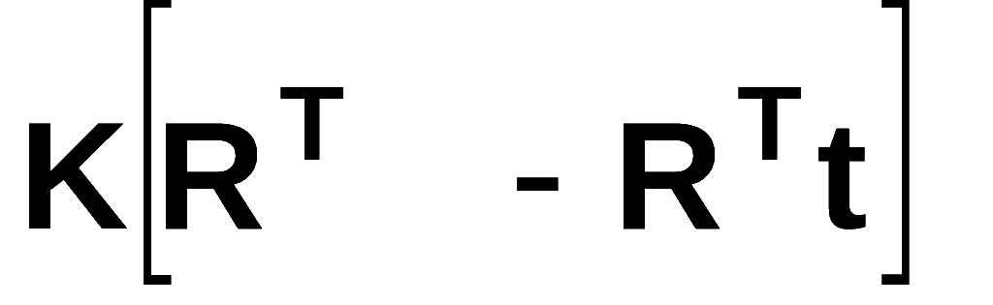




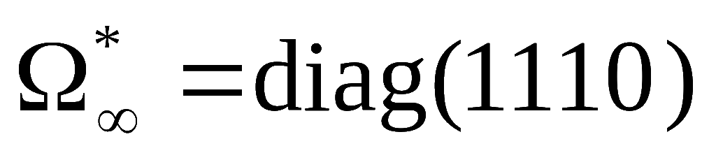
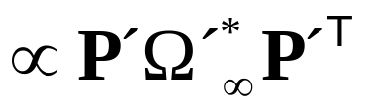
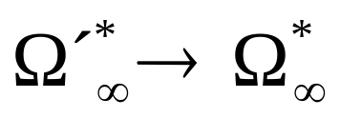
Absolute Dual Quadric and Self-calibration
Eliminate extrinsics from equation
Equivalent to projection of dual quadric
Abs.Dual Quadric also exists in projective world
Transforming world so that
reduces ambiguity to metric

Slide 36
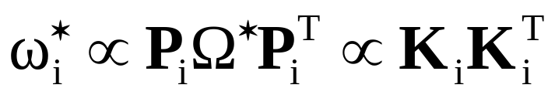
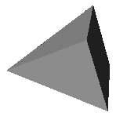
Absolute Dual Quadric and Self-calibration
Projection equation:
Ω*
Translate constraints on K through projection equation to constraints on Ω*
ω*
projection
constraints
Absolute conic = calibration object which is
always present but can only be observed
through constraints on the intrinsics

Slide 37
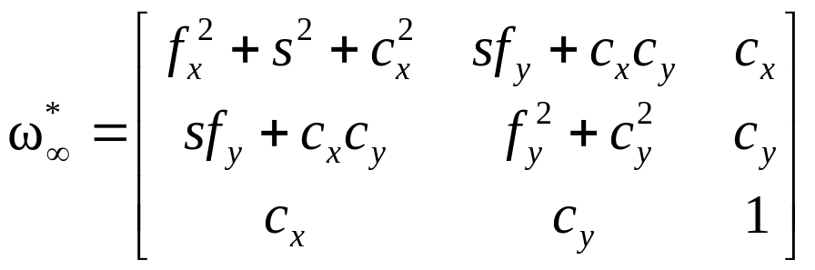






Constraints on ω*∞
condition
constraint
type
#constraints
Zero skew |  | quadratic | m
Principal point |  | linear | 2m
Zero skew (& p.p.) |  | linear | m
Fixed aspect ratio (& p.p.& Skew) |  | quadratic | m-1
Known aspect ratio (& p.p.& Skew) |  | linear | m
Focal length (& p.p. & Skew) |  | linear | m

Slide 38
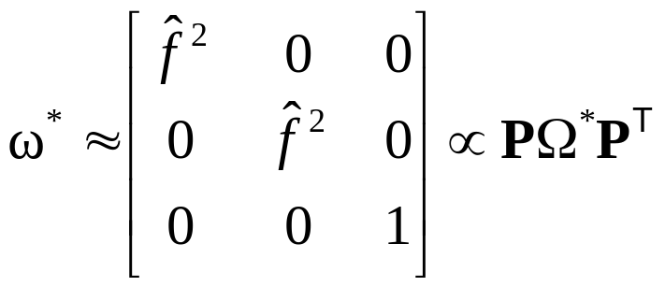
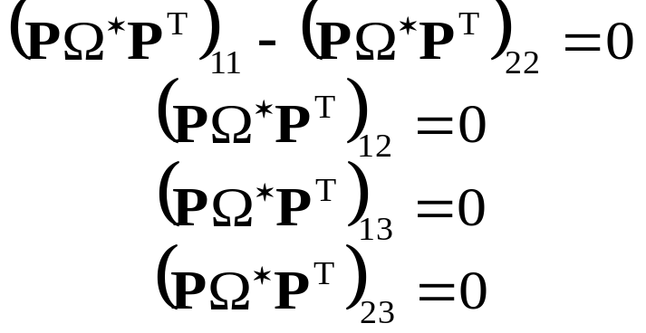
Linear algorithm
(Pollefeys et al.,ICCV´98/IJCV´99)
Assume everything known, except focal length
Yields 4 constraint per image
Note that rank-3 constraint is not enforced

Slide 39
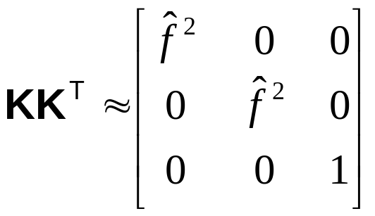




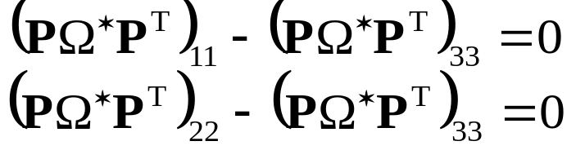
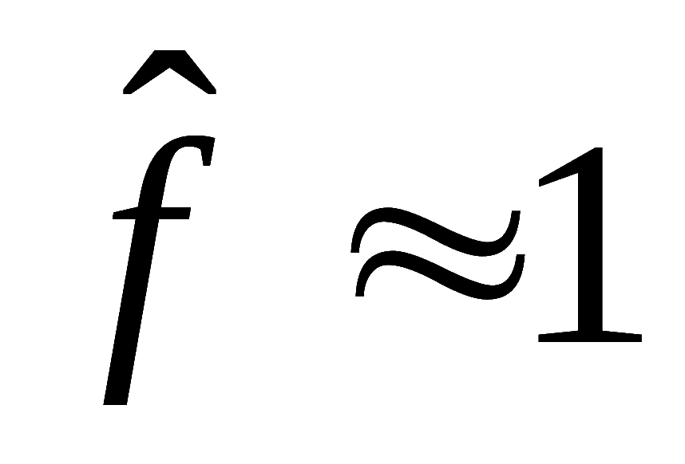



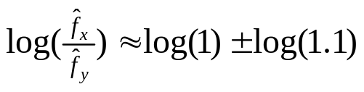

Linear algorithm revisited
(Pollefeys et al., ECCV‘02)
Weighted linear equations
assumptions

Slide 40
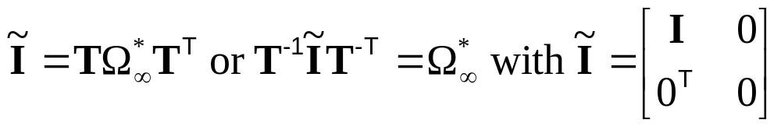

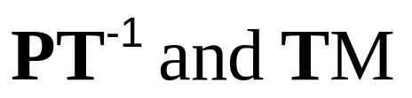

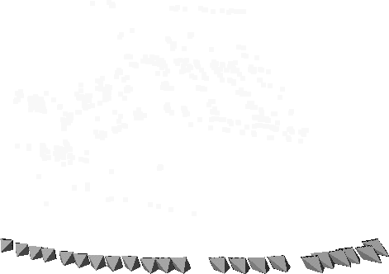
Projective to metric
Compute T from
using eigenvalue decomposition of
and then obtain metric reconstruction as

Slide 41
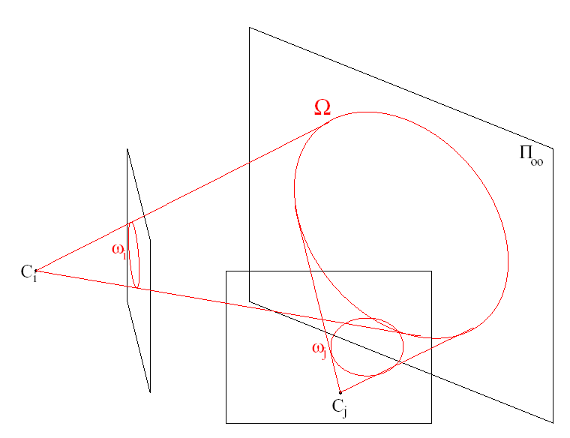
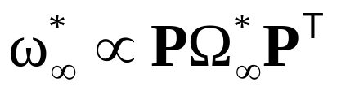
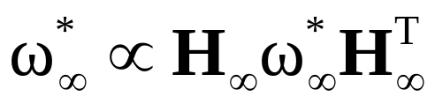
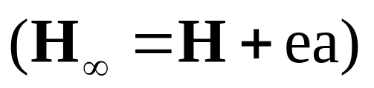
Alternatives:
(Dual) image of absolute conic
Equivalent to Absolute Dual Quadric
Practical when H∞ can be computed first
  Pure rotation (Hartley’94, Agapito et al.’98,’99)
  Vanishing points, pure translations, modulus constraint, …

Slide 42


Note that in the absence of skew the IAC
can be more practical than the DIAC!

Slide 43

Kruppa equations
    Limit equations to epipolar geometry
    Only 2 independent equations per pair
    But independent of plane at infinity

Slide 44

Refinement
Metric bundle adjustment
Enforce constraints or priors
on intrinsics during minimization
(this is „self-calibration“ for photogrammetrist)

Slide 45
Outline
Introduction
Self-calibration
Dual Absolute Quadric
Critical Motion Sequences

Slide 46
Critical motion sequences
(Sturm, CVPR´97, Kahl, ICCV´99, Pollefeys,PhD´99)
Self-calibration depends on camera motion
Motion sequence is not always general enough
Critical Motion Sequences have more than one potential absolute conic satisfying all constraints
Possible to derive classification of CMS

Slide 47
Critical motion sequences: constant intrinsic parameters
Most important cases for constant intrinsics
Critical motion type | ambiguity
pure translation | affine transformation (5DOF)
pure rotation | arbitrary position for Π∞ (3DOF)
orbital motion | proj.distortion along rot. axis (2DOF)
planar motion | scaling axis ⊥ plane (1DOF)
Note relation between critical motion sequences and restricted motion algorithms

Slide 48
Critical motion sequences: varying focal length
Most important cases for varying focal length (other parameters known)
Critical motion type | ambiguity
pure rotation | arbitrary position for Π∞ (3DOF)
forward motion | proj.distortion along opt. axis (2DOF)
translation and rot. about opt. axis | scaling optical axis (1DOF)
hyperbolic and/or elliptic motion | one extra solution

Slide 49

Critical motion sequences: algorithm dependent
Additional critical motion sequences can exist for some specific algorithms
  when not all constraints are enforced
  (e.g. not imposing rank 3 constraint)
  Kruppa equations/linear algorithm: fixating a point
Some spheres also project to circles located in the image and hence satisfy all the linear/kruppa self-calibration constraints

Slide 50


Non-ambiguous new views for CMS
(Pollefeys,ICCV´01)
restrict motion of virtual camera to CMS
use (wrong) computed camera parameters

Slide 51
Next class:
Multiple View Reconstruction

